Slide 1

SREENIDHI INSTITUTE OF SCIENCE AND TECHNOLOGY (An Autonomous Institution Approved by UGC) Yamnampet, Ghatkesar, R.R. District -501 301 Department of Data Science
Group Project – I
On
“Personalised News Feed Generator”
by
Amrutha Varshini (21311A6727)
Vivek sai Sheelam (21311A6718)
Dr. Divya Naadem, Dr. K. Premnadh
Associate Professors Dr. Jaffer Sadiq
Professor
Head Of Department

Slide 2


Personalized Newsfeed Generator
Imagine a newsfeed tailored to your unique interests. This presentation outlines the design and functionality of a personalized newsfeed generator, powered by content-based filtering.

Slide 3


Introduction to Personalized Newsfeed
User-Centric
It prioritizes the delivery of relevant and engaging content, enhancing the user experience.
Tailored Content
It filters information based on individual preferences, ensuring users receive content aligned with their interests.
Enhanced Engagement
It encourages users to stay informed and actively engage with relevant news and articles.

Slide 4
Existing System : Hybrid Approach
Collaborative Filtering
And other various algorithms
Hybrid Approach
Leverages user interactions and feedback to recommend similar content to others with shared interests.
Recommends items based on various factors
Combines both collaborative and other techniques for a more comprehensive recommendation system.

Slide 5


Proposed System : Recommendation based on Content-based Filtering
1
Content Extraction
Extracts relevant information from news articles, such as keywords, topics, and categories.
2
TF-IDF Calculation
Term Frequency-Inverse Document Frequency(TF-IDF) is used to determine the importance of each word in the articles. then we will find cosine similarity to find the similar news headlines.
3
User Profiling
Creates user profiles based on the TF-IDF scores of articles they have engaged with..

Slide 6





Control Flow
User Interaction
Users interact with the newsfeed by clicking on articles, subscribing to topics, or providing feedback.
Content Extraction
The system extracts relevant information from news articles, including keywords, topics, and categories.
User Profiling
User profiles are updated based on their interactions and preferences, reflecting their evolving interests.
Content Matching
The system matches relevant articles to user profiles based on their preferences.
Ranking and Prioritization
Articles are ranked based on their relevance and presented in a personalized newsfeed.

Slide 7


Continuously Updating the Newsfeed
The newsfeed is constantly updated based on user interactions and preferences. The system analyzes user behavior, such as clicks, scrolls, and dwell time, to refine user profiles and improve content matching. Feedback mechanisms, such as "like" and "dislike" buttons, provide explicit signals about user preferences, further enhancing the personalization process.

Slide 8

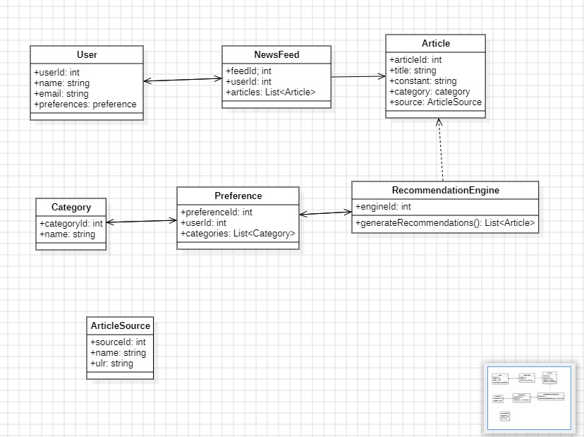
Class Diagram

Slide 9
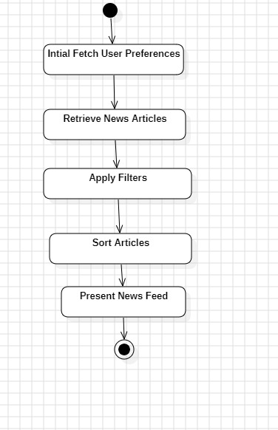
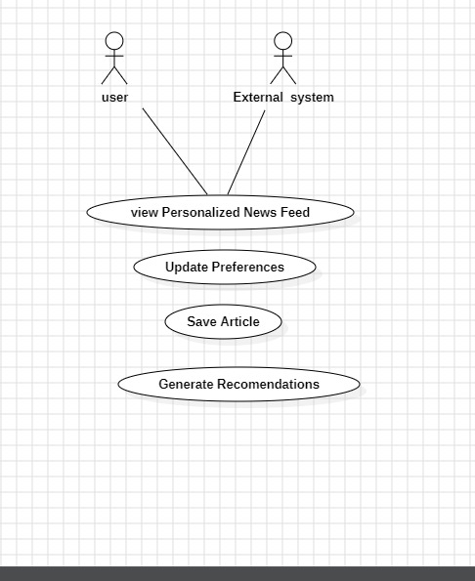
Activity Diagram
State Chart Diagram

Slide 10
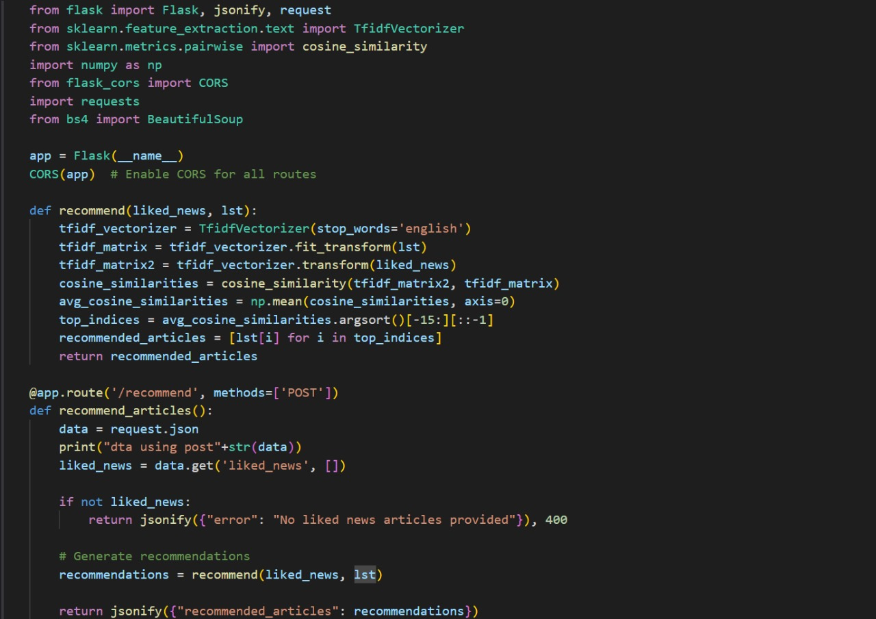
CODE IMPLEMENTATION

Slide 11
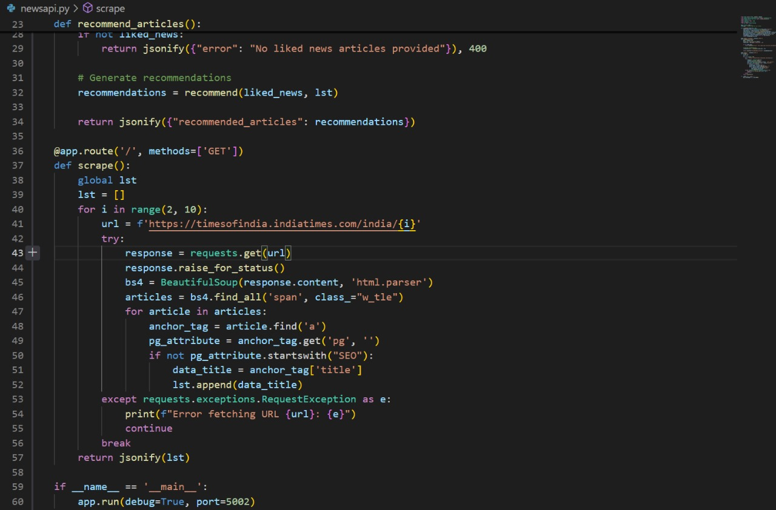

Slide 12
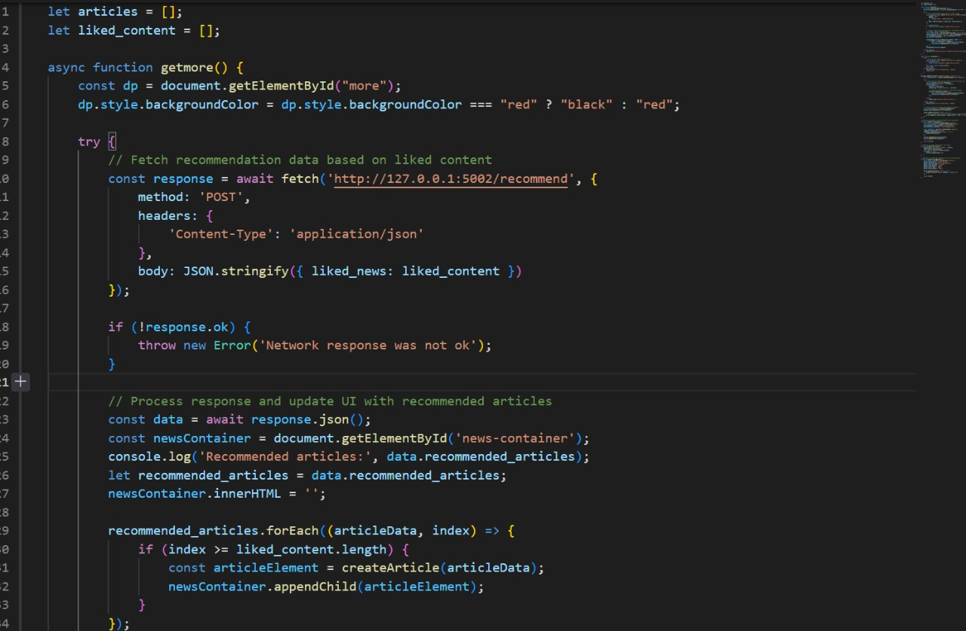

Slide 13
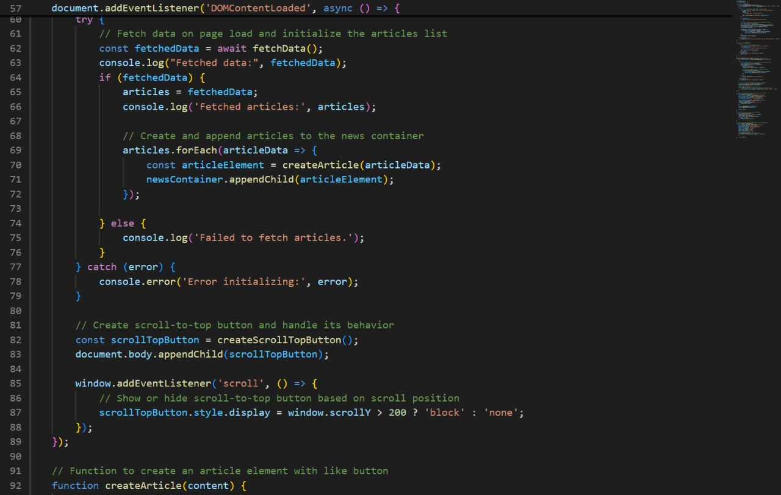

Slide 14
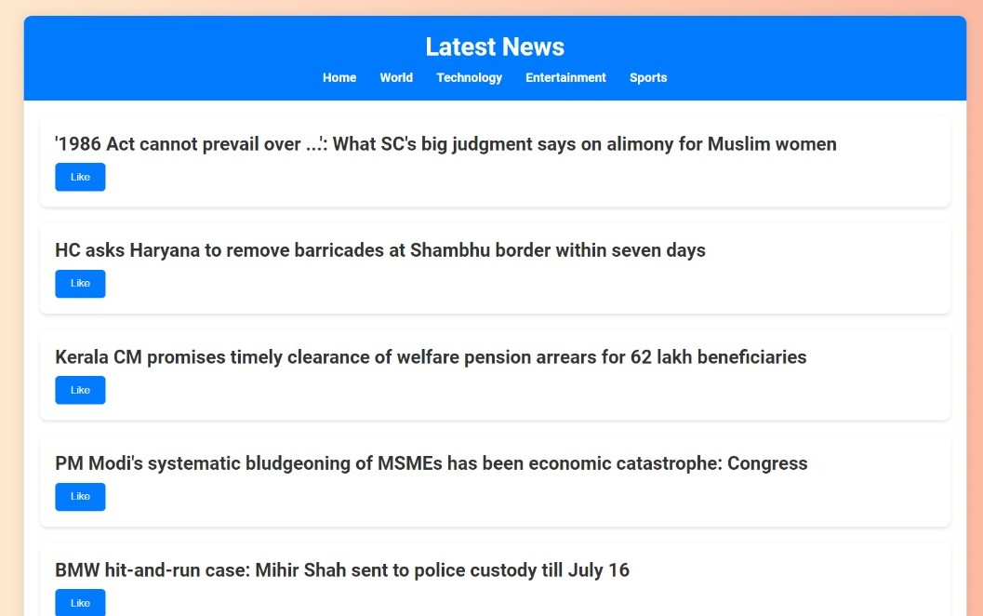
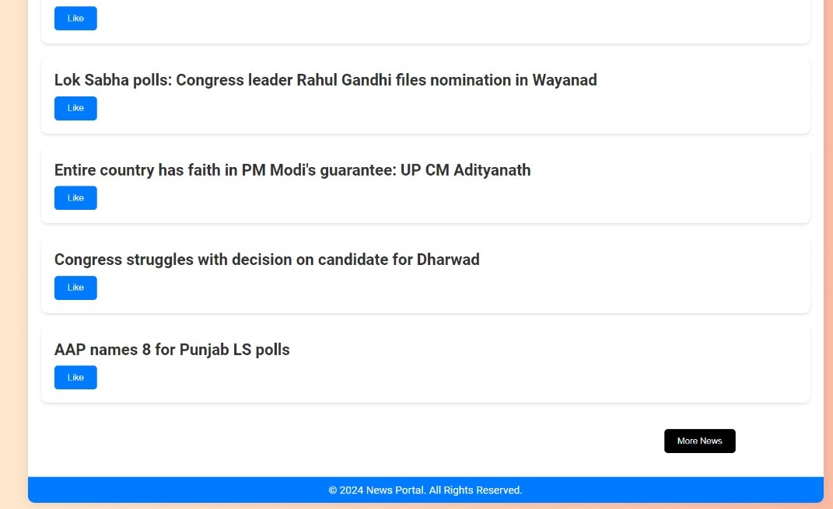
OUTPUT :

Slide 15
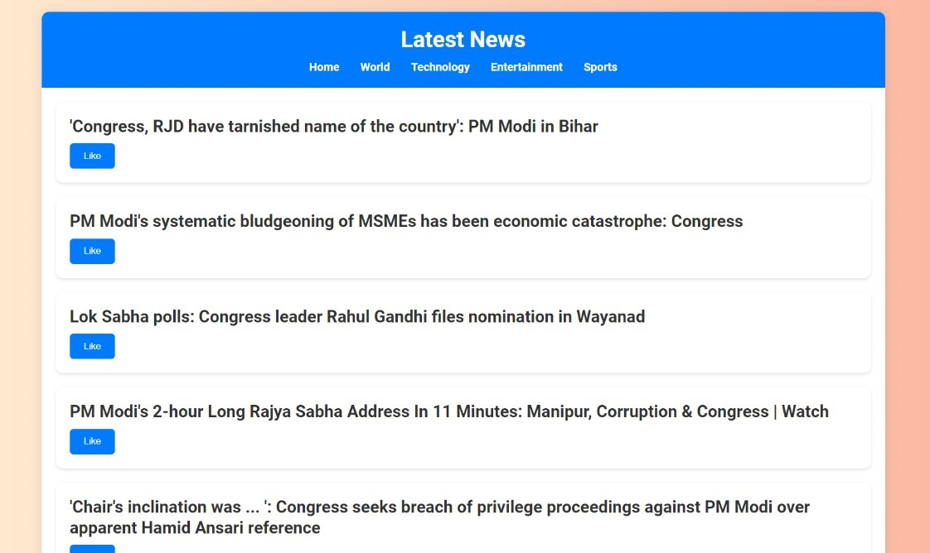

Slide 16
Conclusion
In conclusion, the proposed personalized newsfeed system offers a robust and adaptive solution to deliver relevant and engaging content to users. By leveraging content-based filtering and continuous learning from user interactions, the system ensures that each individual's newsfeed is tailored to their unique interests and preferences. This approach not only enhances the user experience, but also promotes diversity in the content consumed, exposing users to a wider range of perspectives and ideas. As the system continuously evolves, it will become an invaluable tool in today's fast-paced and information-rich digital landscape.

Slide 17


